Slide 1
Data Communication
5CS204
-Ms.A.S.Pawar

Slide 2
Course Objectives
The objective of the course is to provide a foundation and clear understanding of various concepts of data communication which will form basis of computer networking. Objectives are further divided as:
1. To elaborate various features and operations of data communication.
2. To inculcate protocol functions and issues related to Data Link layer.
3. To introduce the design and configuration of various networking techniques.

Slide 3
Course Outcomes
CO | After the completion of the course the student should be able to | Bloom’s Cognitive
 |  | level | Descriptor
CO1 | describe fundamental concepts of data communication system. | 2 | Understanding
CO2 | interpret various concepts related to data link layer protocols. | 3 | Applying
CO3 | differentiate and analyze various data communication techniques | 4 | Analyzing

Slide 4
Books
Textbooks: Behrouz A. Forouzan, “Data communication and Networking”, Tata McGraw-Hill, 4th/5th Edition, 2017. William Stallings, “Data and Computer Communications”, Prentice Hall(PHI) , 8th /9th Edition, 2010/2011
References: James F. Kurose and Keith W. Ross, “Computer Networking: A Top-Down Approach Featuring the Internet”, Pearson Education,5th /7th edition, 2012/2016

Slide 5
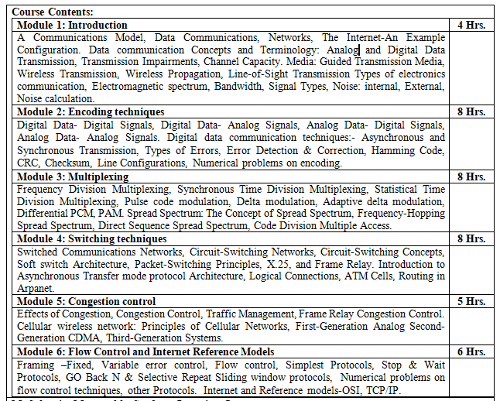

Slide 6
Introduction
Data communications deals with the transmission of signals in a reliable and efficient manner.
Topics covered include signal transmission, transmission media, signal encoding, interfacing, data link control, and multiplexing.
Networking deals with the technology and architecture of the communications networks used to interconnect communicating devices.
This field is generally divided into the topics of local area networks (LANs) and wide area networks (WANs).

Slide 7
A Communications Model

Slide 8
A Communications Model
Modem: takes a digital bit stream from an attached device such as a personal computer and transforms that bit stream into an analog signal that can be handled by the telephone network.
Transmission system utilization : refers to the need to make efficient use of transmission facilities that are typically shared among a number of communicating devices.
Multiplexing: used to allocate the total capacity of a transmission medium among a number of users.
Congestion control techniques: used to assure that the system is not overwhelmed by excessive demand for transmission services.

Slide 9
A Communications Model
To communicate, a device must interface with the transmission system :all the forms of communication depend on the use of electromagnetic signals propagated over a transmission medium.
once an interface is established, signal generation is required for communication.
The properties of the signal, such as form and intensity, must be such that the signal is
capable of being propagated through the transmission system
interpretable as data at the receiver.

Slide 10
Communication Tasks

Slide 11
A Data Communications Model
m=message
g= sequence of bits
[g(t)]=sequence of voltage shifts
S(t)=signal suitable for transmission

